Slide 1
SCST1213 Mathematics For SE
CHAPTER 2
NUMBER THEORY
nzah@utm.my

Slide 2
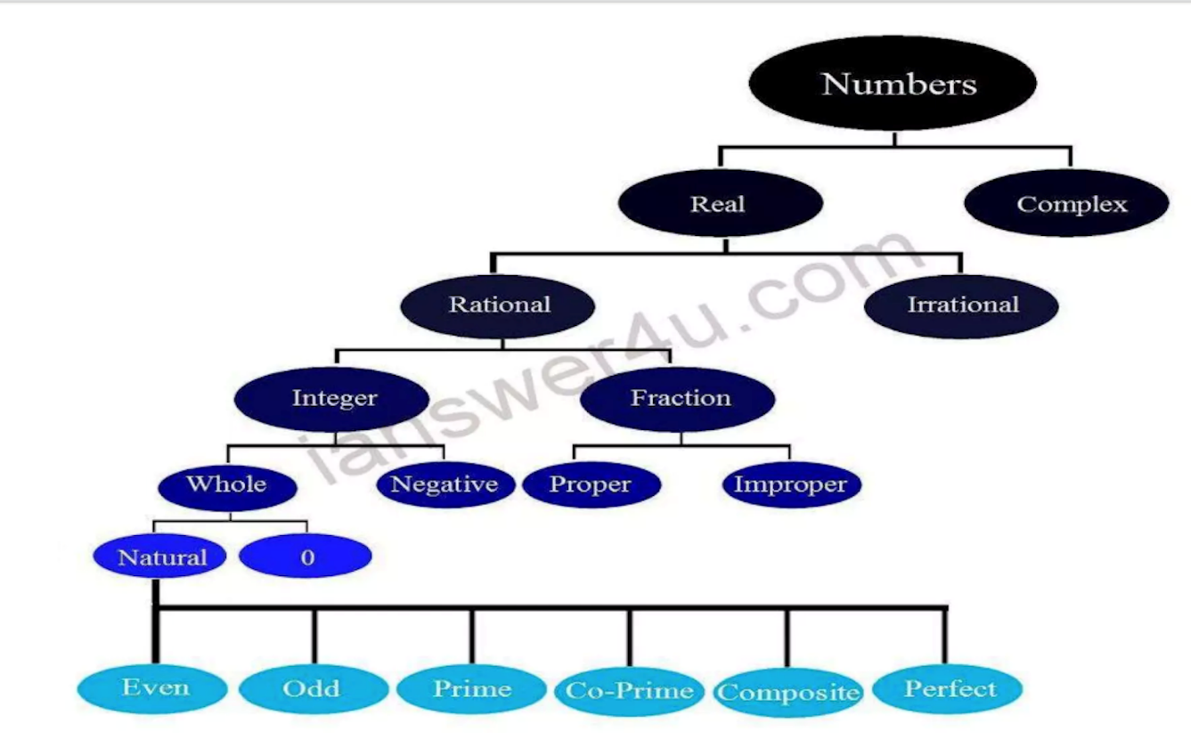
SCST1213 Mathematics For SE
Number Theory
Sets
Number Theory or Theory of Numbers is a part of Discrete Mathematics, about integers and their properties.
2
nzah@utm.my

Slide 3
Application
Cryptography: securing online transaction using large prime number
Computer science : algorithms for encryption and hashing

Slide 4
SCST1213 Mathematics For SE
Number Theory
Sets
In this syllabus, we will discuss the key concept of this theory as follows:
  1.1: Divisibility and Modular Arithmetic
  1.2: Integer Representations and Algorithms
  1.3: Primes and Greatest Common Divisors (GCD)
4
nzah@utm.my

Slide 5
SCST1213 Mathematics For SE
1.1: Divisibility and Modular Arithmetic
Division of an integer by a positive integer produces a quotient and a reminder.
The remainders lead to modular arithmetic, which play an important role in mathematics and used in CS.
5
nzah@utm.my

Slide 6
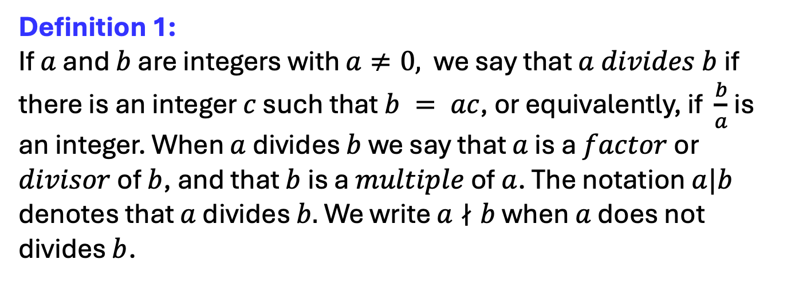
SCST1213 Mathematics For SE
1.1: Divisibility and Modular Arithmetic
DIVISION
Definition 1:
If $a$ and $b$ are integers with $a≠0,$we say that $a divides b$ if there is an integer $c$ such that $b = ac$, or equivalently, if $\frac{b}{a}$ is an integer. When $a$ divides $b$ we say that $a$ is a $factor$ or $divisor$ of $b$, and that $b$ is a $multiple$ of $a$. The notation $a|b$ denotes that $a$ divides $b.$ We write $a∤b$ when $a$ does not divides $b$.
6
nzah@utm.my

Slide 7
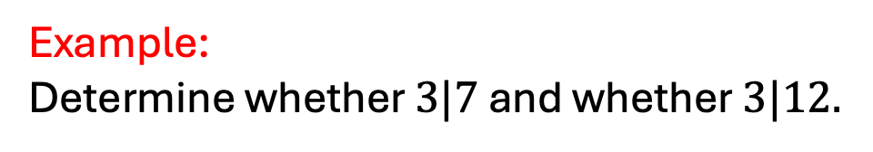
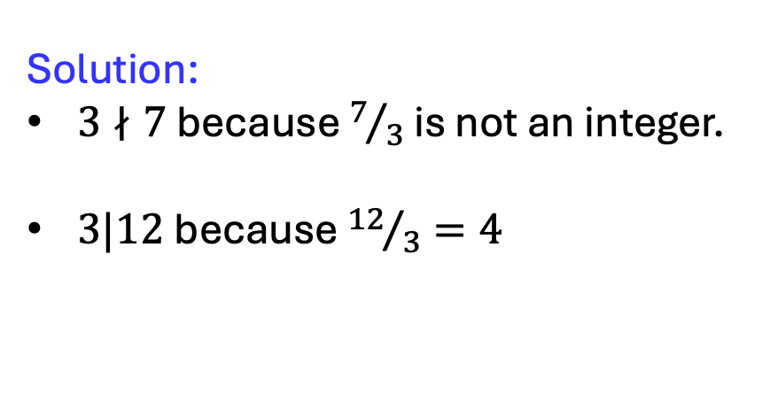
SCST1213 Mathematics For SE
1.1: Divisibility and Modular Arithmetic
DIVISION
Example:
Determine whether $3|7$ and whether $3|12.$
Solution:
$3∤7$ because $7/3$is not an integer.
$3|12$because ${12}/3=4$
7
nzah@utm.my

Slide 8
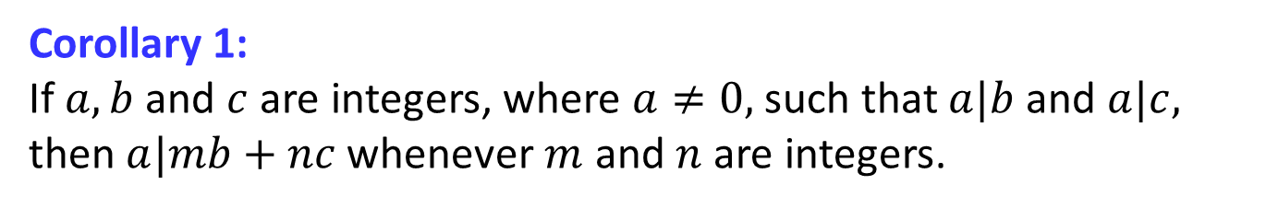
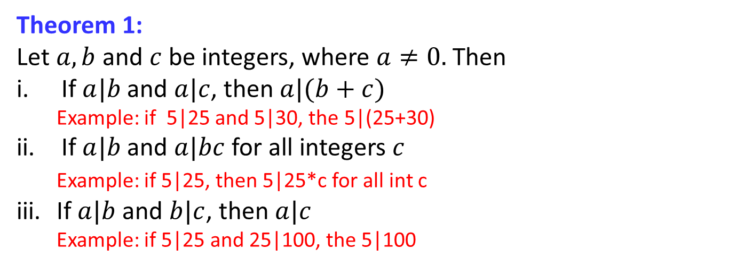
SCST1213 Mathematics For SE
1.1: Divisibility and Modular Arithmetic
DIVISION
Theorem 1:
Let $a, b$ and $c$ be integers, where $a≠0.$Then
If $a|b$and $a|c$, then $a|(b+c)$
  Example: if 5|25 and 5|30, the 5|(25+30)
If $a|b$and $a|bc$ for all integers $c$
Example: if 5|25, then 5|25*c for all int c
iii. If $a|b$and $b|c$, then $a|c$
  Example: if 5|25 and 25|100, the 5|100
Corollary 1:
If $a, b$ and $c$ are integers, where $a≠0,$such that $a|b$and $a|c,$ then $a|mb+nc$whenever $m$ and $n$ are integers.
8
nzah@utm.my

Slide 9
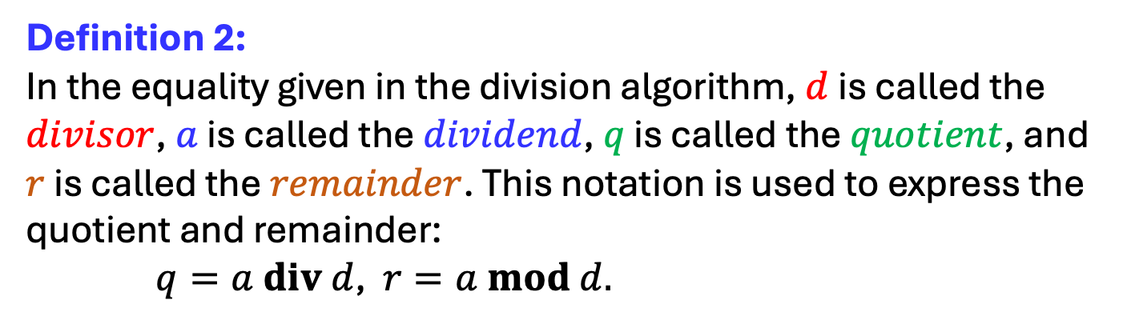
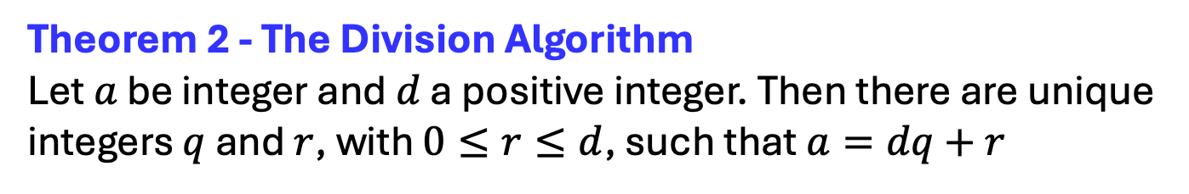
SCST1213 Mathematics For SE
1.1: Divisibility and Modular Arithmetic
THE DIVISION ALGORITHM
Theorem 2 - The Division Algorithm
Let $a$ be integer and $d$ a positive integer. Then there are unique integers $q$ and $r$, with $0≤r≤d$, such that $a=dq+r$
Definition 2:
In the equality given in the division algorithm, $d$ is called the $divisor$, $a$ is called the $dividend$, $q$ is called the $quotient$, and $r$ is called the $remainder$. This notation is used to express the quotient and remainder:
$q=a div d$, $r=a mod d.$
9
nzah@utm.my

Slide 10
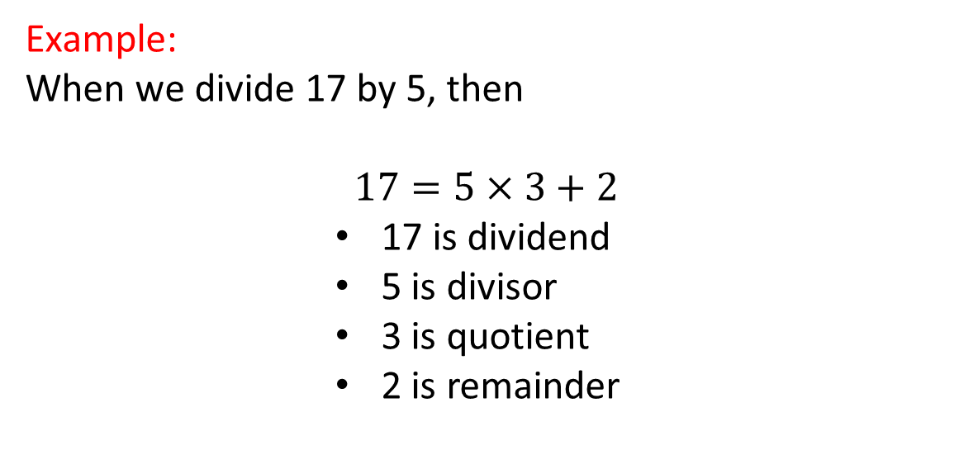
SCST1213 Mathematics For SE
1.1: Divisibility and Modular Arithmetic
THE DIVISION ALGORITHM
Example:
When we divide 17 by 5, then
$$17=5×3+2$$
          17 is dividend
          5 is divisor
          3 is quotient
          2 is remainder
10
nzah@utm.my

Slide 11
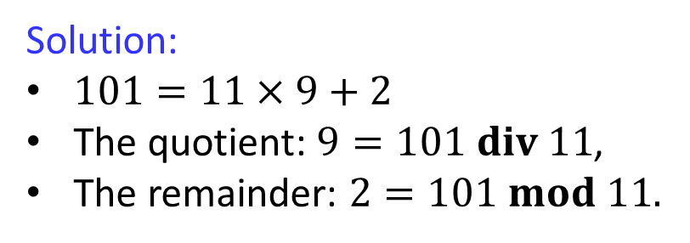
SCST1213 Mathematics For SE
1.1: Divisibility and Modular Arithmetic
THE DIVISION ALGORITHM
Example:
What are the quotient and reminder when 101 is divided by 11?
Solution:
$101=11×9+2$
The quotient: $9=101 div 11$,
The remainder: $2=101 mod 11.$
11
nzah@utm.my

Slide 12
1.1: Divisibility and Modular Arithmetic
THE DIVISION ALGORITHM
What happens when we divide -11 by 3 ?
Note that the remainder cannot be negative.
-11 = 3⋅(-4) + 1.
-11 is the dividend,
3 is the divisor,
-4 is called the quotient, and
1 is called the remainder.

Slide 13
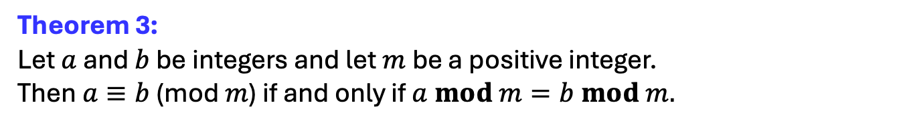
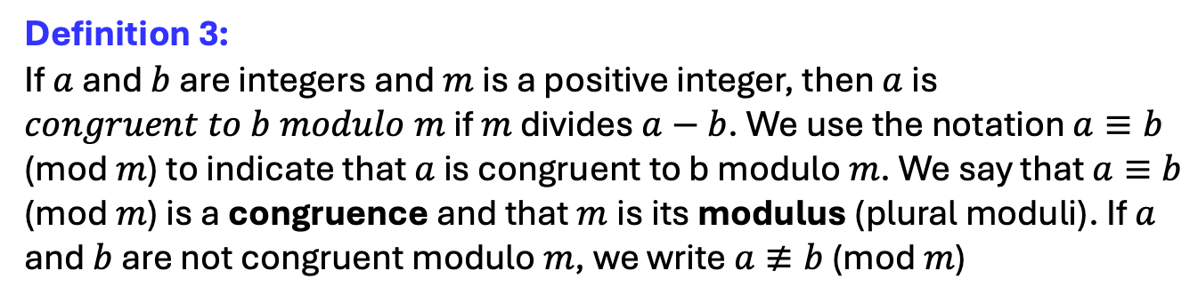
SCST1213 Mathematics For SE
1.1: Divisibility and Modular Arithmetic
MODULAR ARITHMETIC
Definition 3:
If $a$ and $b$ are integers and $m$ is a positive integer, then $a$ is $congruent to b modulo m$ if $m$ divides $a−b$. We use the notation $a≡b$ (mod $m$) to indicate that $a$ is congruent to b modulo $m$. We say that $a≡b$ (mod $m$) is a congruence and that $m$is its modulus (plural moduli). If $a$ and $b$ are not congruent modulo $m$, we write $a≢b$ (mod $m$)
Theorem 3:
Let $a$ and $b$ be integers and let $m$ be a positive integer.
Then $a≡b$ (mod $m$) if and only if $a mod m=b mod m.$
13
nzah@utm.my

Slide 14
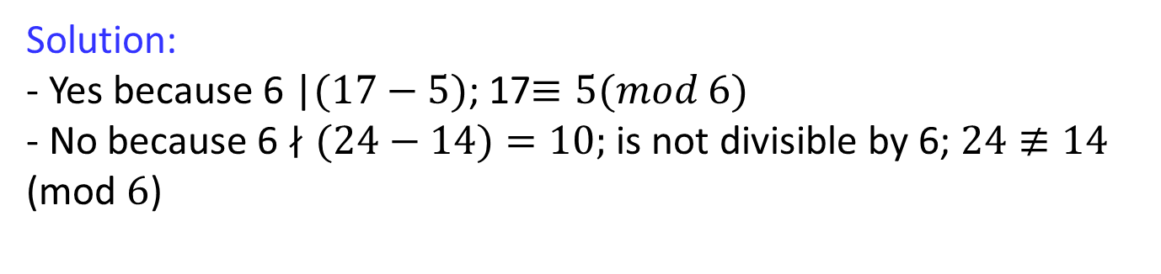
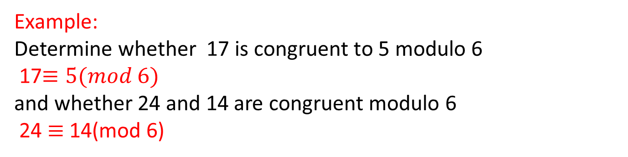
SCST1213 Mathematics For SE
1.1: Divisibility and Modular Arithmetic
MODULAR ARITHMETIC
Example:
Determine whether 17 is congruent to 5 modulo 6
17$≡5(mod 6)$
and whether 24 and 14 are congruent modulo 6
24 $≡$ 14(mod 6)
Solution:
- Yes because 6 |$(17−5)$; 17$≡5(mod 6)$
- No because 6 $∤(24−14)=10;$ is not divisible by 6; $24≢14$ (mod $6$)
14
nzah@utm.my

Slide 15
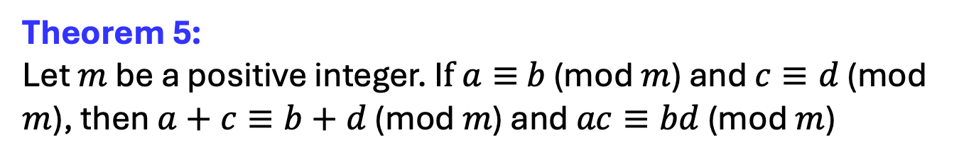
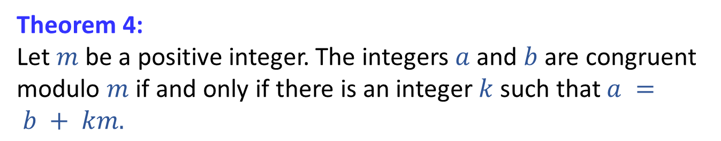
SCST1213 Mathematics For SE
1.1: Divisibility and Modular Arithmetic
MODULAR ARITHMETIC
Theorem 4:
Let $m$ be a positive integer. The integers $a$ and $b$ are congruent modulo $m$ if and only if there is an integer $k$ such that $a = b + km.$
Theorem 5:
Let $m$ be a positive integer. I$f a≡$ $b$ (mod $m$) and $c≡d$ (mod $m$), then $a+c≡b+d$ (mod $m$) and $ac≡bd$ (mod $m$)
15
nzah@utm.my

Slide 16
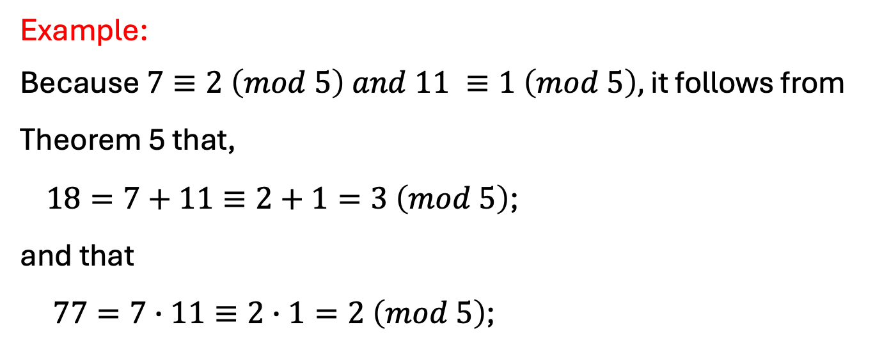
SCST1213 Mathematics For SE
1.1: Divisibility and Modular Arithmetic
MODULAR ARITHMETIC
Example:
Because $7≡2 \left(mod 5\right) and 11 ≡1 \left(mod 5\right),$ it follows from Theorem 5 that,
$18=7+11≡2+1=3 \left(mod 5\right)$;
and that
$77=7∙11≡2∙1=2 \left(mod 5\right)$;
16
nzah@utm.my

Slide 17
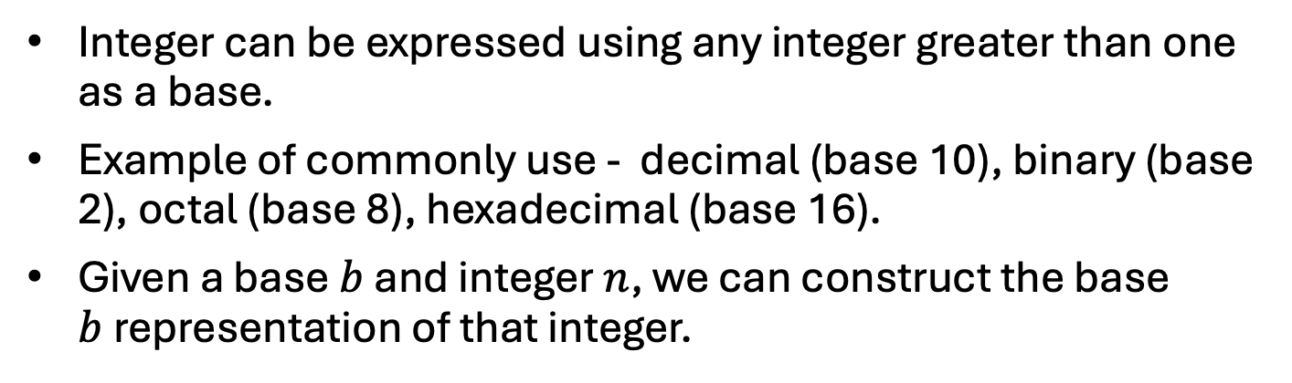
SCST1213 Mathematics For SE
1.2: Integer Representations and Algorithm
Integer can be expressed using any integer greater than one as a base.
Example of commonly use - decimal (base 10), binary (base 2), octal (base 8), hexadecimal (base 16).
Given a base $b$ and integer $n$, we can construct the base $b$representation of that integer.
17
nzah@utm.my

Slide 18
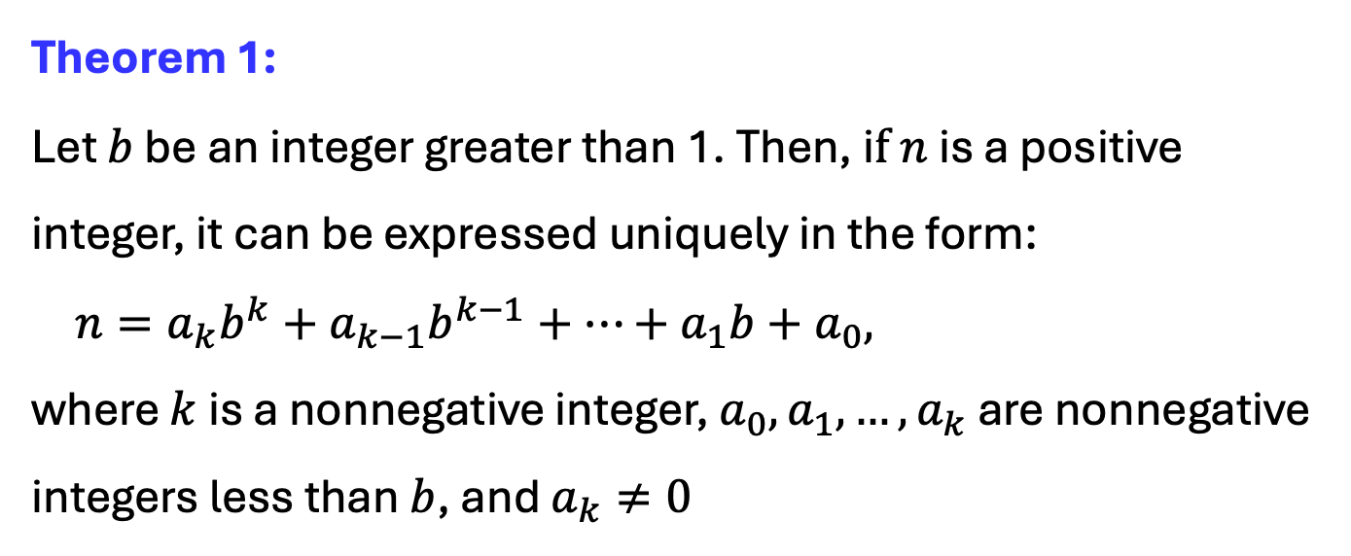
SCST1213 Mathematics For SE
1.2: Integer Representations and Algorithm
REPRESENTATIONS OF INTEGERS
Theorem 1:
Let $b$ be an integer greater than 1. Then, i$f n$ is a positive integer, it can be expressed uniquely in the form:
$n=a_{k}b^{k}+a_{k−1}b^{k−1}+…+a_{1}b+a_{0},$
where $k$ is a nonnegative integer, $a_{0}, a_{1},…,a_{k}$ are nonnegative integers less than $b$, and $a_{k}≠0$
18
nzah@utm.my

Slide 19
SCST1213 Mathematics For SE
1.2: Integer Representations and Algorithm
REPRESENTATIONS OF INTEGERS
Binary Expansions:
Choosing 2 as the base gives binary expansions of integers.
In binary notation each digit is either 0 or 1.
Binary expansion of an integer is just a bit string.
It’s used by computer to represent and do arithmetic with integer.
19
nzah@utm.my

Slide 20
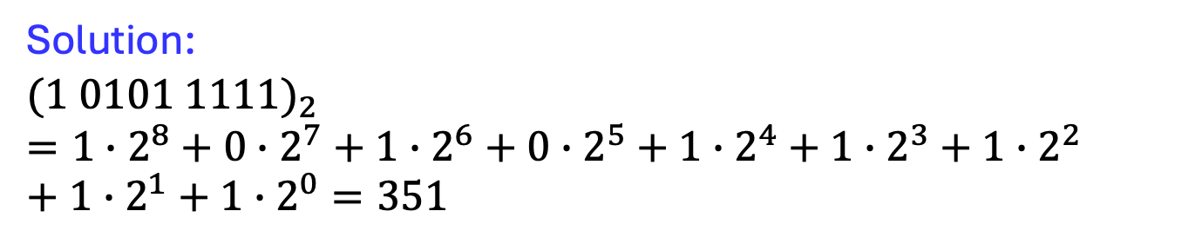
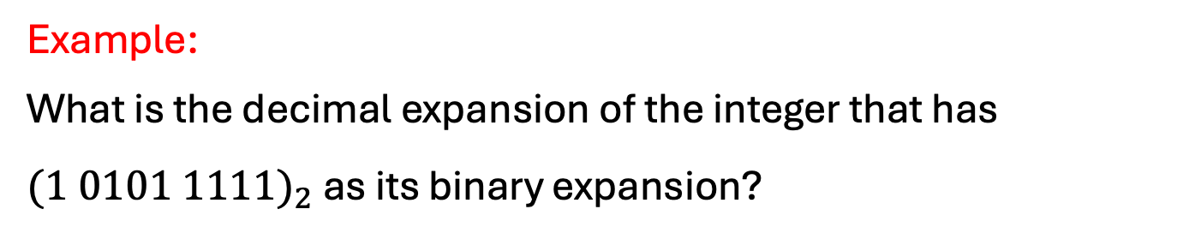
SCST1213 Mathematics For SE
1.2: Integer Representations and Algorithm
REPRESENTATIONS OF INTEGERS
Example:
What is the decimal expansion of the integer that has ${(1 0101 1111)}_{2}$ as its binary expansion?
Solution:
$${(1 0101 1111)}_{2}=1∙2^{8}+0∙2^{7}+{1∙2}^{6}+{0∙2}^{5}+1∙2^{4}{+ 1∙2}^{3}+ {1∙2}^{2}+{1∙2}^{1}+{1∙2}^{0}=351$$
20
nzah@utm.my

Slide 21
SCST1213 Mathematics For SE
1.2: Integer Representations and Algorithm
REPRESENTATIONS OF INTEGERS
Octal and Hexadecimal Expansions:
Among the most important bases in CS are base 2, 8 and 16.
Base 8 expansions are called octal expansions.
Base 16 expansions are hexadecimal expansions.
Sixteen different digits are required for hexadecimal expansions. Usually, the hexadecimal digits used are 0,1, 2, 3, 4, 5, 6, 7, 8, 9, A, B, C, D, E and F, where the letters A through F represent the digits corresponding to the numbers 10 through 15 (in decimal notation).
21
nzah@utm.my

Slide 22
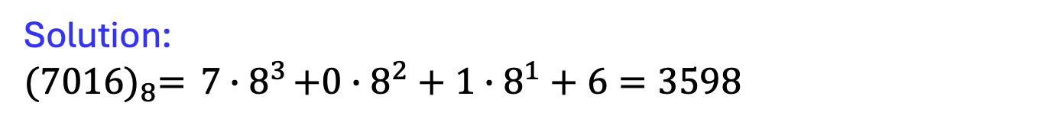
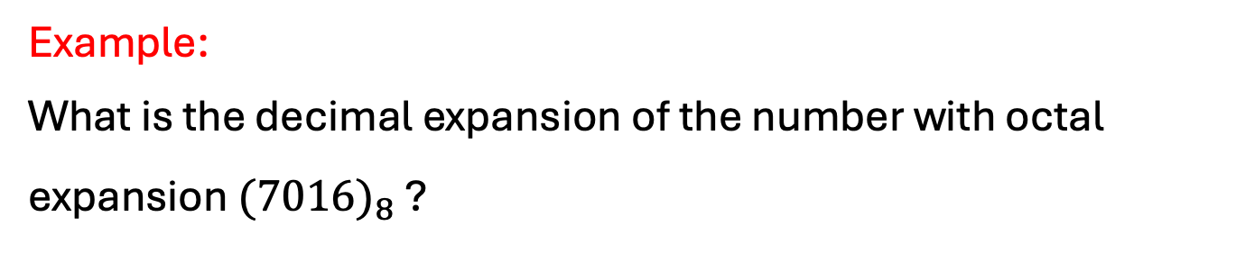
SCST1213 Mathematics For SE
1.2: Integer Representations and Algorithm
REPRESENTATIONS OF INTEGERS
Example:
What is the decimal expansion of the number with octal expansion ${(7016)}_{8}$ ?
Solution:
$${(7016)}_{8}={ 7∙8}^{3}+{0∙8}^{2}+{1∙8}^{1}+6=3598$$
22
nzah@utm.my

Slide 23
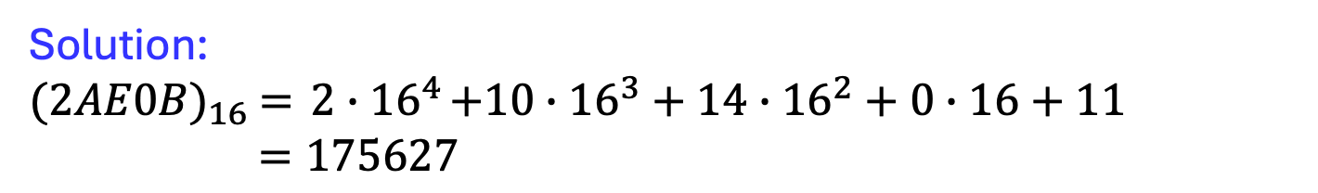
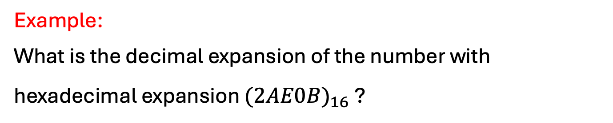
SCST1213 Mathematics For SE
1.2: Integer Representations and Algorithm
REPRESENTATIONS OF INTEGERS
Example:
What is the decimal expansion of the number with hexadecimal expansion ${(2AE0B)}_{16}$ ?
Solution:
$${(2AE0B)}_{16} ={ 2∙16}^{4}+{10∙16}^{3}+{14∙16}^{2}+0∙16+11$$
$=175627$
23
nzah@utm.my

Slide 24



SCST1213 Mathematics For SE
1.2: Integer Representations and Algorithm
REPRESENTATIONS OF INTEGERS
Each hexadecimal digit can be represented using four bits.
For example:
$${\text{(}1110)}_{2}={(E)}_{16}$$
$${(1110 0101)}_{2} ={(E5)}_{16}$$
$${(0101)}_{2}={(5)}_{16}$$
24
nzah@utm.my

Slide 25
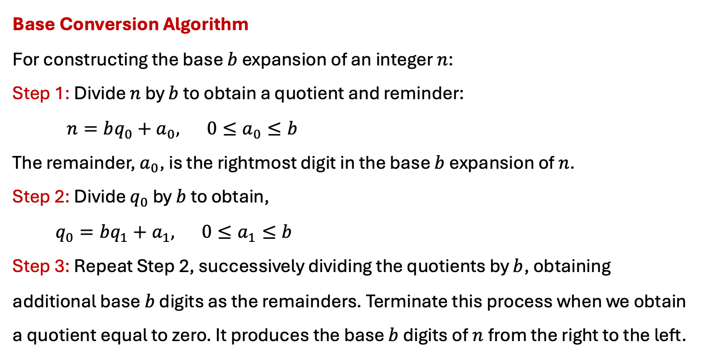
SCST1213 Mathematics For SE
1.2: Integer Representations and Algorithm
REPRESENTATIONS OF INTEGERS
Base Conversion Algorithm
For constructing the base $b$ expansion of an integer $n$:
Step 1: Divide $n$ by $b$ to obtain a quotient and reminder:
$n=bq_{0}+a_{0}, 0≤a_{0}≤b$
The remainder, $a_{0}$, is the rightmost digit in the base $b$expansion of $n$.
Step 2: Divide $q_{0}$ by $b$ to obtain,
$q_{0}=bq_{1}+a_{1}, 0≤a_{1}≤b$
Step 3: Repeat Step 2, successively dividing the quotients by $b$, obtaining additional base $b$ digits as the remainders. Terminate this process when we obtain a quotient equal to zero. It produces the base $b$ digits of$n$from the right to the left.
25
nzah@utm.my

Slide 26
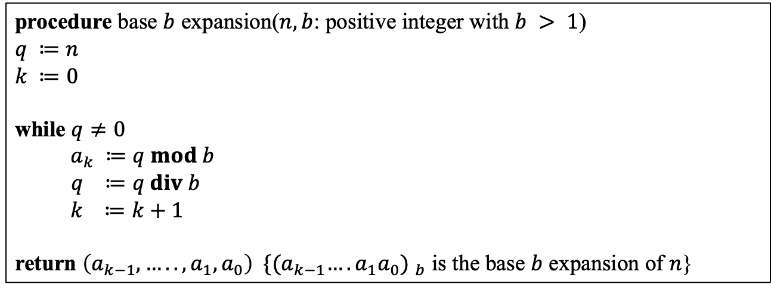
SCST1213 Mathematics For SE
1.2: Integer Representations and Algorithm
REPRESENTATIONS OF INTEGERS
Algorithm 1: Constructing Base $b$ Expansions
procedure base $b$ expansion($n, b$: positive integer with $b > 1$)
$$q ≔n$$
$$k ≔0$$
while $q≠0$
$a_{k} ≔q mod b$
$q ≔q div b$
$k ≔k+1$
return $\left(a_{k−1},…..,a_{1},a_{0}\right) {\{{(a}_{k−1}….a_{1}a_{0}) }_{b}$ is the base $b$ expansion of $n$}
26
nzah@utm.my

Slide 27
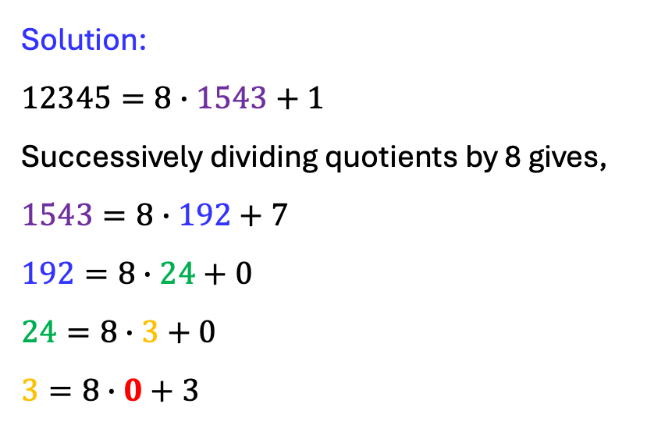
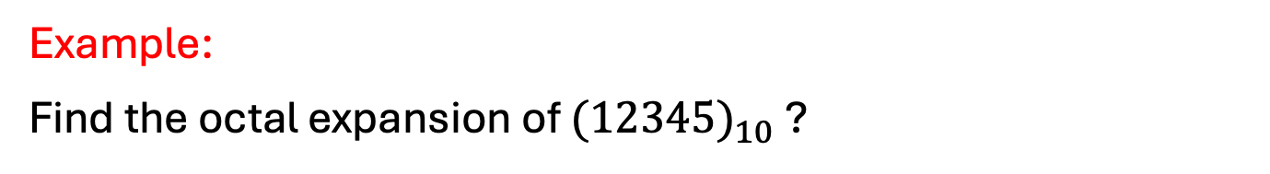

SCST1213 Mathematics For SE
1.2: Integer Representations and Algorithm
REPRESENTATIONS OF INTEGERS
Example:
Find the octal expansion of ${(12345)}_{10}$ ?
Solution:
$$12345=8∙1543+1$$
Successively dividing quotients by 8 gives,
$$1543=8∙192+7$$
$$192=8∙24+0$$
$$24=8∙3+0$$
$$3=8∙0+3$$
${(12345)}_{10}={(30071)}_{8}$
27
Digit from the right to the left
nzah@utm.my

Slide 28
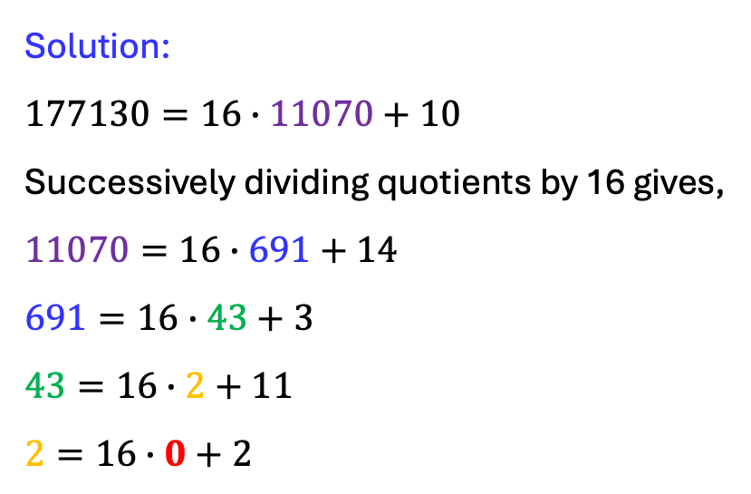


SCST1213 Mathematics For SE
1.2: Integer Representations and Algorithm
REPRESENTATIONS OF INTEGERS
Example:
Find the hexadecimal expansion of ${(177130)}_{10}$ ?
Solution:
$$177130=16∙11070+10$$
Successively dividing quotients by 16 gives,
$$11070=16∙691+14$$
$$691=16∙43+3$$
$$43=16∙2+11$$
$$2=16∙0+2$$
?
${(177130)}_{10}={(2B3EA)}_{16}$
28
nzah@utm.my

Slide 29
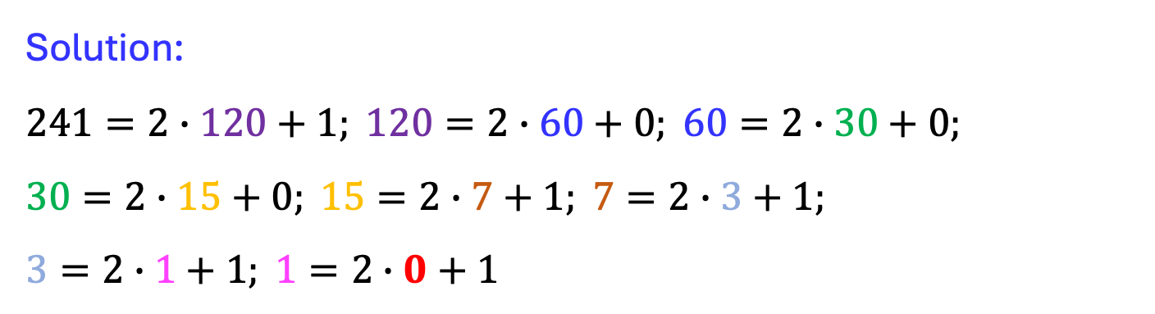
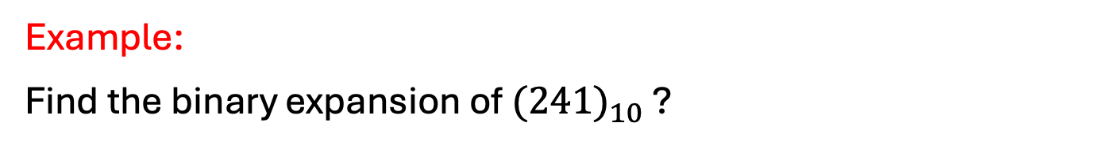

SCST1213 Mathematics For SE
1.2: Integer Representations and Algorithm
REPRESENTATIONS OF INTEGERS
Example:
Find the binary expansion of ${(241)}_{10}$ ?
Solution:
$$241=2∙120+1; 120=2∙60+0; 60=2∙30+0;$$
$$30=2∙15+0; 15=2∙7+1; 7=2∙3+1;$$
$$3=2∙1+1; 1=2∙0+1$$
?
${.: (241)}_{10}={(1111 0001)}_{2}$
29
nzah@utm.my

Slide 30
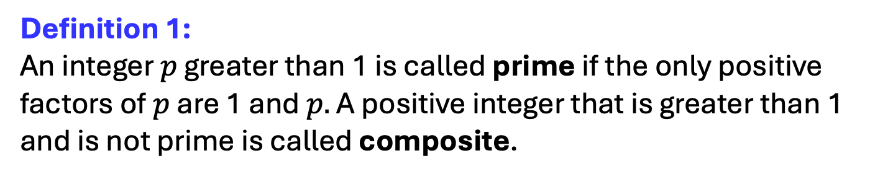
SCST1213 Mathematics For SE
1.3: Primes and Greatest Common Divisors
PRIMES
Definition 1:
An integer $p$ greater than 1 is called prime if the only positive factors of $p$ are 1 and $p.$ A positive integer that is greater than 1 and is not prime is called composite.
Example:
Prime => 2, 3, 5, 7,….
Composite => 4, 6, 8, 9,……
30
nzah@utm.my

Slide 31
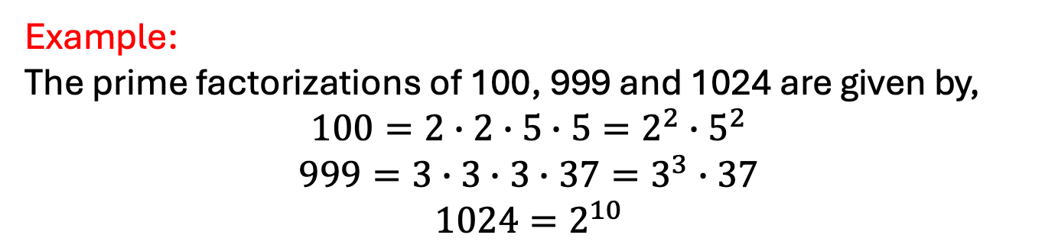
SCST1213 Mathematics For SE
1.3: Primes and Greatest Common Divisors
PRIMES
Theorem 1:
Every integer greater than 1 can be written uniquely as a prime or as the product of two or more primes where the prime factors are written in order of nondecreasing size.
Example:
The prime factorizations of 100, 999 and 1024 are given by,
$$100=2∙2∙5∙5=2^{2}∙5^{2}$$
$$999=3∙3∙3∙37=3^{3}∙37$$
$$1024=2^{10}$$
31
nzah@utm.my

Slide 32
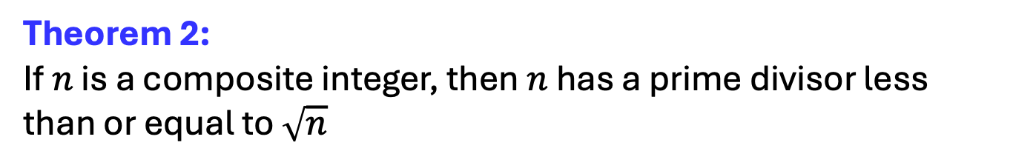
SCST1213 Mathematics For SE
1.3: Primes and Greatest Common Divisors
TRIAL DIVISION
Theorem 2:
If $n$ is a composite integer, then $n$ has a prime divisor less than or equal to $\sqrt{n}$
Theorem 3:
There are infinitely many prime.
32
nzah@utm.my

Slide 33
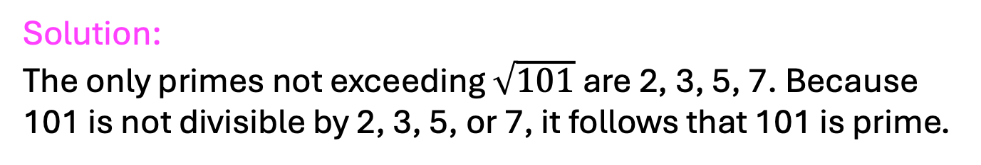
SCST1213 Mathematics For SE
1.3: Primes and Greatest Common Divisors
TRIAL DIVISION
Example:
Show that 101 is prime.
Solution:
The only primes not exceeding $\sqrt{101}$are 2, 3, 5, 7. Because 101 is not divisible by 2, 3, 5, or 7, it follows that 101 is prime.
33
nzah@utm.my

Slide 34
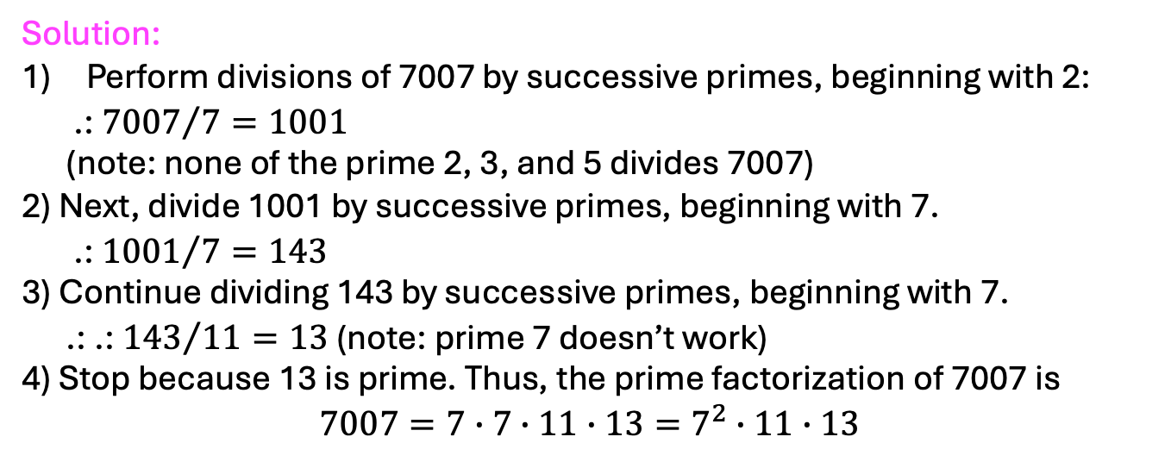
SCST1213 Mathematics For SE
1.3: Primes and Greatest Common Divisors
TRIAL DIVISION
Example:
Find the prime factorization of 7007.
Solution:
Perform divisions of 7007 by successive primes, beginning with 2:
.: ${7007}/7=1001$
(note: none of the prime 2, 3, and 5 divides 7007)
2) Next, divide 1001 by successive primes, beginning with 7.
.: ${1001}/7=143$
3) Continue dividing 143 by successive primes, beginning with 7.
.: .: ${143}/{11}=13$ (note: prime 7 doesn’t work)
4) Stop because 13 is prime. Thus, the prime factorization of 7007 is
$$7007=7∙7∙11∙13=7^{2}∙11∙13$$
34
nzah@utm.my

Slide 35
SCST1213 Mathematics For SE
1.3: Primes and Greatest Common Divisors
EXERCISE
Find the prime factorizations for the followings:
15
48
512
515
35
nzah@utm.my

Slide 36
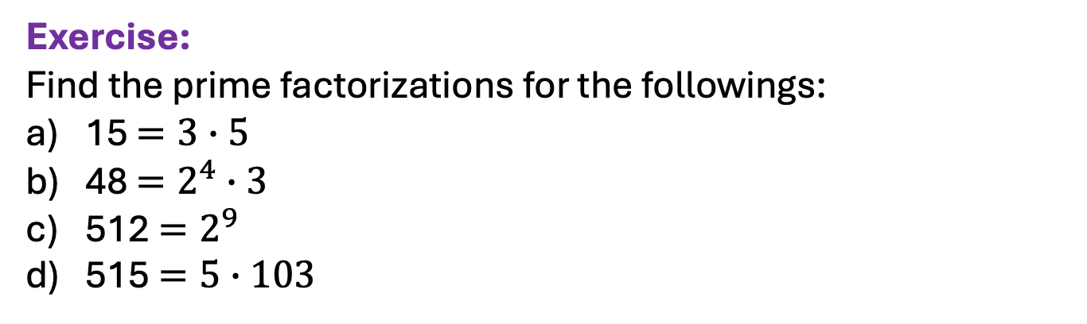
SCST1213 Mathematics For SE
1.3: Primes and Greatest Common Divisors
PRIMES
Exercise:
Find the prime factorizations for the followings:
15 $=3∙5$
48 $=2^{4}∙3$
512 $=2^{9}$
515 $=5∙103$
36
nzah@utm.my

Slide 37
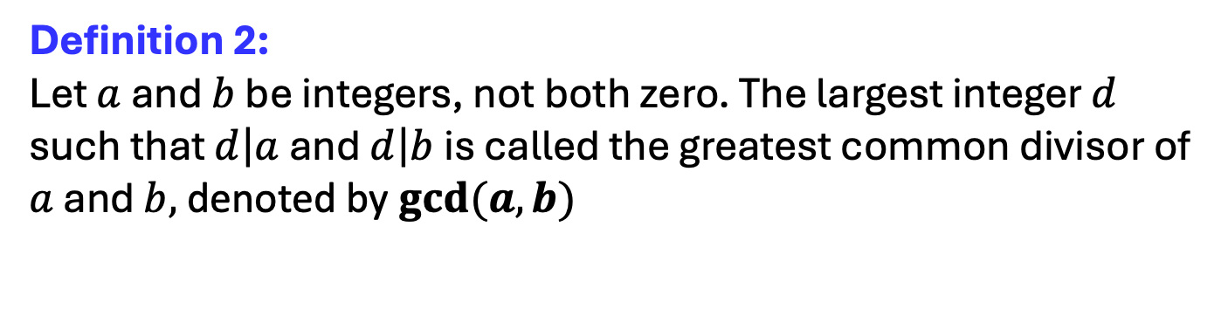
SCST1213 Mathematics For SE
1.3: Primes and Greatest Common Divisors
GREATEST COMMON DIVISORS
Definition 2:
Let $a$ and $b$ be integers, not both zero. The largest integer $d$ such that $\left.d\right|a$ and $\left.d\right|b$ is called the greatest common divisor of $a$ and $b,$denoted by $gcd⁡(a,b)$
37
nzah@utm.my

Slide 38
SCST1213 Mathematics For SE
1.3: Primes and Greatest Common Divisors
GREATEST COMMON DIVISORS
Example:
What is the greatest common divisor of 24 and 36?
Solution:
The positive common divisors of 24 & 36 are 1, 2, 3, 4, 6 and 12. Hence, gcd(24,36) = 12.
38
nzah@utm.my

Slide 39
SCST1213 Mathematics For SE
1.3: Primes and Greatest Common Divisors
GREATEST COMMON DIVISORS
Example:
What is the greatest common divisor of 17 and 22?
Solution:
The integer 17 and 22 have no positive common divisors other than 1. So, gcd(17,22) = 1.
39
nzah@utm.my

Slide 40
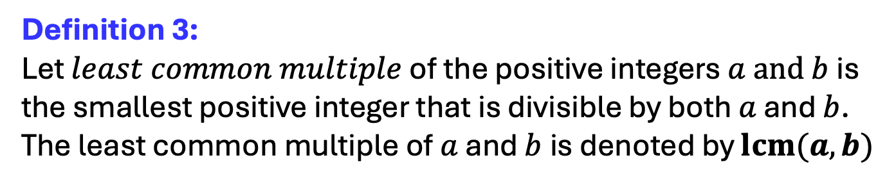
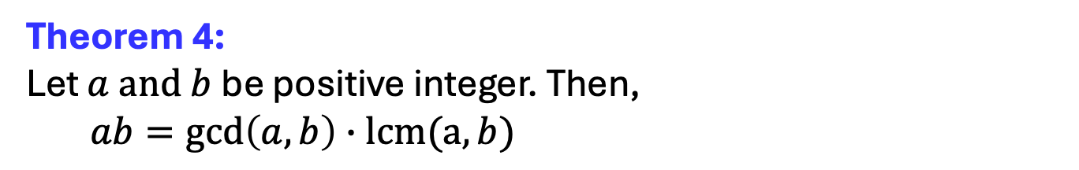
SCST1213 Mathematics For SE
1.3: Primes and Greatest Common Divisors
GCD & LEAST COMMON MULTIPLES
Definition 3:
Let $least common multiple$ of the positive integers $a and b$ is the smallest positive integer that is divisible by both $a$ and $b$. The least common multiple of $a$ and $b$is denoted by $lcm⁡(a,b)$
Theorem 4:
Let $a and b$be positive integer. Then,
$ab=gcd\left(a,b\right)∙lcm(a, b)$
40
nzah@utm.my

Slide 41
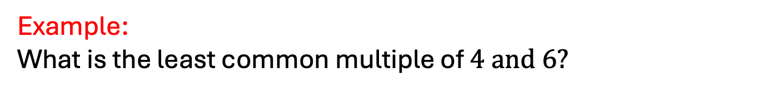
SCST1213 Mathematics For SE
1.3: Primes and Greatest Common Divisors
GCD & LEAST COMMON MULTIPLES
Example:
What is the least common multiple of $4 and 6?$
Solution:
The multiples of 4 are: 4, 8, 12, 16, 20, 24, ...
The multiples of 6 are: 6, 12, 18, 24, 30, ...
The smallest number that appears in both lists is 12, so the lcm(4,6) is 12.
41
nzah@utm.my

Slide 42
SCST1213 Mathematics For SE
1.3: Primes and Greatest Common Divisors
THE EUCLIDEAN ALGORITHM
Computing GCD of two integers directly from the prime factorization is inefficient because it’s time consuming.
The Euclidean algorithm is more efficient to compute GCD.
42
nzah@utm.my

Slide 43
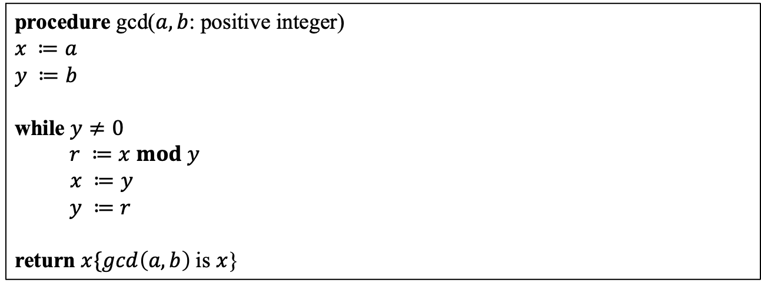
SCST1213 Mathematics For SE
1.3: Primes and Greatest Common Divisors
THE EUCLIDEAN ALGORITHM
procedure gcd($a, b$: positive integer)
$$x ≔a$$
$$y ≔b$$
while $y≠0$
$r ≔x mod y$
$x ≔y$
$y ≔r$
return $x\{gcd\left(a,b\right)$is $x$}
43
nzah@utm.my

Slide 44
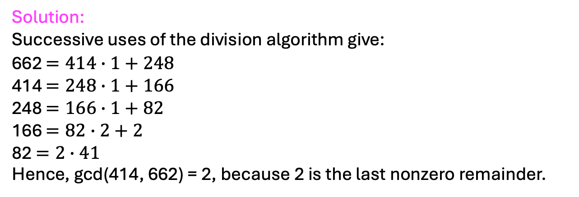
SCST1213 Mathematics For SE
1.3: Primes and Greatest Common Divisors
THE EUCLIDEAN ALGORITHM
Example:
Find the greatest common divisor of 414 and 662 using the Euclidean algorithm.
Solution:
Successive uses of the division algorithm give:
662 $=414∙1+248$
414 $=248∙1+166$
248 $=166∙1+82$
166 $=82∙2+2$
82 $=2∙41$
Hence, gcd(414, 662) = 2, because 2 is the last nonzero remainder.
44
nzah@utm.my

Slide 45
SCST1213 Mathematics For SE
1.3: Primes and Greatest Common Divisors
EXERCISES
How many divisions are required to find the GCD of 34 and 55 using the Euclidean algorithm? Then, write the gcd(34,55) value.
Find the GCD of 56 and 98 using the Euclidean algorithm.
Determine the greatest common divisor of 120 and 45 by applying the prime factorization method.
45
nzah@utm.my

Slide 46
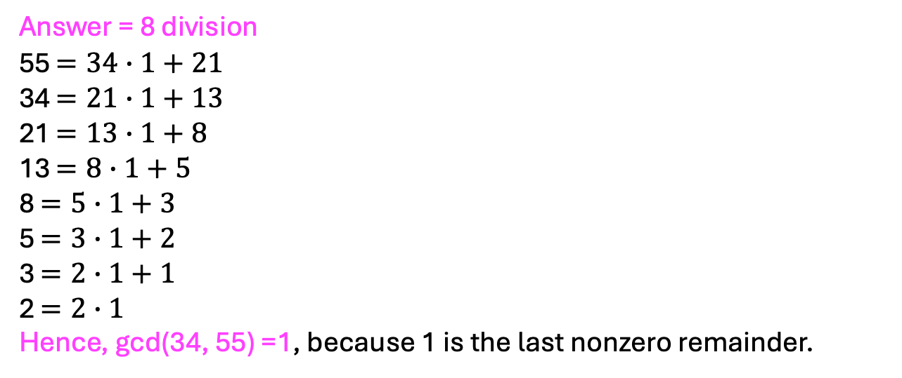
SCST1213 Mathematics For SE
1.3: Primes and Greatest Common Divisors
EXERCISES - Solution (1)
Answer = 8 division
55 $=34∙1+21$
34 $=21∙1+13$
21 $=13∙1+8$
13 $=8∙1+5$
8 $=5∙1+3$
5 $=3∙1+2$
3 $=2∙1+1$
2 $=2∙1$
Hence, gcd(34, 55) =1, because 1 is the last nonzero remainder.
46
nzah@utm.my

Slide 47
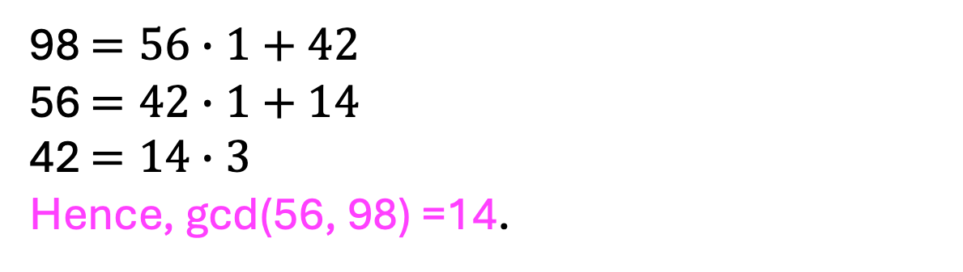
SCST1213 Mathematics For SE
1.3: Primes and Greatest Common Divisors
EXERCISES - Solution (2)
98 $=56∙1+42$
56 $=42∙1+14$
42 $=14∙3$
Hence, gcd(56, 98) =14.
47
nzah@utm.my

Slide 48
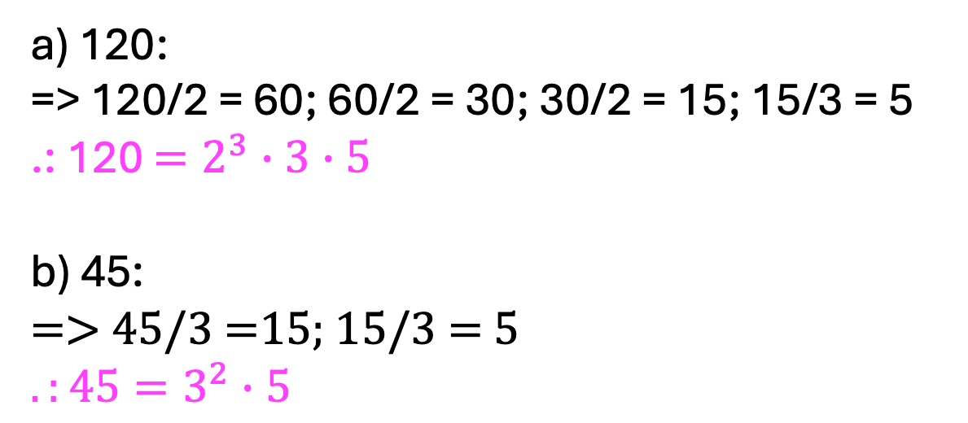
SCST1213 Mathematics For SE
1.3: Primes and Greatest Common Divisors
EXERCISES - Solution (3)
a) 120:
=> 120/2 = 60; 60/2 = 30; 30/2 = 15; 15/3 = 5
.: 120 $=2^{3}∙3∙5$
b) 45:
=> 45/3 =15; 15/3 = 5
$$.:45=3^{2}∙5$$
48
nzah@utm.my

